Slide 1
DBMS Project
Online Voting System
Submitted to: Prof. Geetanjali Bhola
Submitted By: Rohit Kumar Sah(2K20/IT/123)
Shivam Kumar(2K20/IT/132)

Slide 2
Table of contents
01
03
Introduction
About Project
02
04
Concepts Used
Conclusion

Slide 3
Introduction
Internet voting system can be a viable alternative for conducting an election and such a voting system must provide the same level of security as ordinary paper based elections.

Slide 4
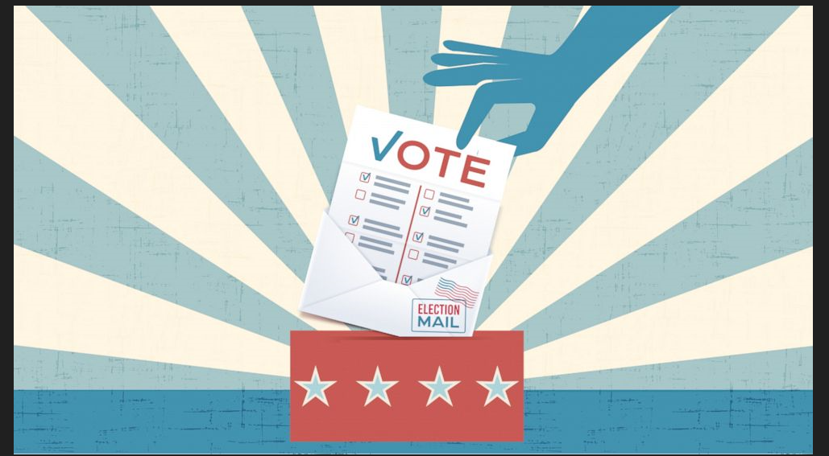
Problems of current voting system
1. The process of manual voting is very time consuming.
2. The electronic voting machine used is very expensive.
3. The current voting system requires more manual power and time for ballot counting.
4. Voters must be present in his/her constituency to give his/her vote.
5. The current system leads to conflict.

Slide 5
About
1. This online voting system is easy to use and its design is very simple and also reliable.
2. “Online Voting System” is and online voting technique. In this system people who have citizenship of India and whose age is above 18 years and any sex can give his/her vote online without going to any physical status.
3. There is a database which is maintained in which all the names of voters with complete information.

Slide 6
Drawbacks
Vulnerability to hacking
Political ties of manufacturers
Malicious software programming
Physical Security of Machines

Slide 7
Conclusion
1. Our proposed system enables a voter to cast their vote through internet without going to voting booth and additionally registering themselves for voting in advance.
2. Fast to access, easy to maintain all information of voting, highly efficient and flexible.
3. There are a few challenges that must be overcome in order that their benefits may be fully realized. There is a challenge of voter’s education. The electorate needs to be educated adequately on the use of online voting.

Slide 8
References
Slideshare
Wikipedia
Bartleby.com
Europa.eu

